Slide 1
sp_2 PROJECT SEMINAR ON “ADVANCE ENCRYPTION STANDARD USING PYTHON”

Slide 2


Special Project-II final term Seminar
Presentation
Supervisor
Mr. B.Deevena Raju
Associate Professor
Department of Data Science and Artificial intelligence
Project Done By
Kuralla Sravya Sai Sree 20STUCHH010265

Slide 3
Introduction
The security of data transmitted across a global network has turned into a key factor on the network performance measures.
The aim of this project is to develop a new approach to hiding a secret information in an image,text ,audio ,video by taking advantage of benefits of combining cryptography and steganography.

Slide 4
Purpose
The purpose of this project is to provide the correct data with security to the users.
We can use this program in any where like hospitals, schools, colleges, data center to keep the data secured and files to be safe.
The image can only be viewed by the receiver as the image is encrypted using AES and the key is only known to the sender and receiver.
Since the image is encrypted using AES, it is more secure than the DES and triple DES.

Slide 5
Existing system
The existing system based on AES comprises two block ciphers: AES-128, AES-192 .
There is only possibility hiding a secret information in and text ,audio ,video .
It is not available to secure the data in image format .

Slide 6
Proposed system
The proposed system based on AES comprises two block ciphers: AES-128, AES-192 ,AES-256
The image is more secure than DES and triple DES because it is encrypted using AES.
It is more secured and it used for image ,texrt,audio and vedio.

Slide 7
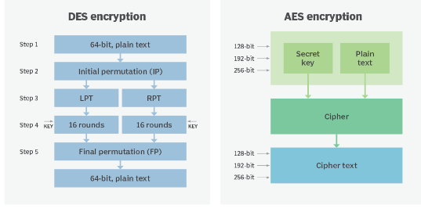
The existing and proposed system .

Slide 8
SCOPE
The scope of the project is to maintain the secure the data.
we can encrypt the data image, video, PDF, and some other files.
By encrypting the data the data is secured and the normal person can not understand the files data. We encrypt the data by the password and we again decrypt the data by same password. We use the AES algorithm so they is very chances to decode the file expect if the password is week.

Slide 9
This project has a broad scope because it includes the following features that make it simple to use, understand, and modify:
The files will be secure and safe.
Improving the security in the system by providing AES algroithm
It used in hospitals, schools, colleges,offices etc.. for security purpose.
It will reduce the threat or riskiness.

Slide 10
Requirements Specification
A. Software Requirements
Operating system : Windows XP Professional
Text Editor : Visual Studio or IDLE (PYTHON)
Language : PYTHON 3.0
B. Hardware Requirements
Processor : PENTIUM III 866 MHz
RAM: 128 MD SD RAM
Monitor: 15’’ COLOUR
Hard disk:20GB
Foppy drive:1.44 MB
CD drive : LG 52X
Keyboard : STANDARD102 KEYS
Mouse : 3 BUTTONS

Slide 11
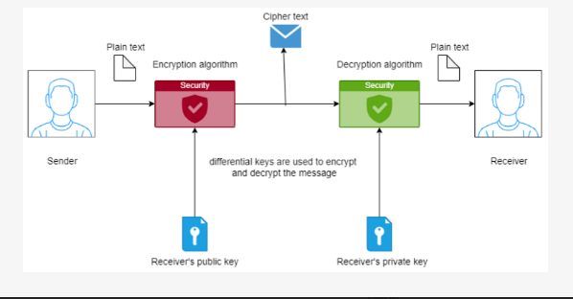
SYSTEM ARCHITECTURE :

Slide 12
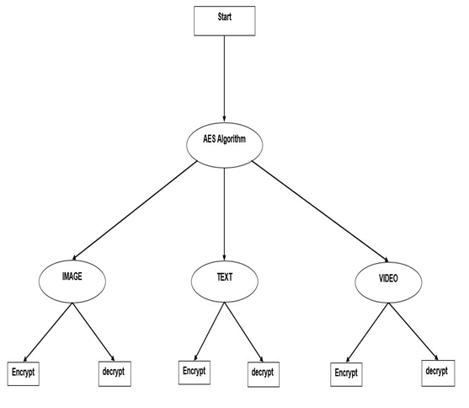
Functional Requirements

Slide 13
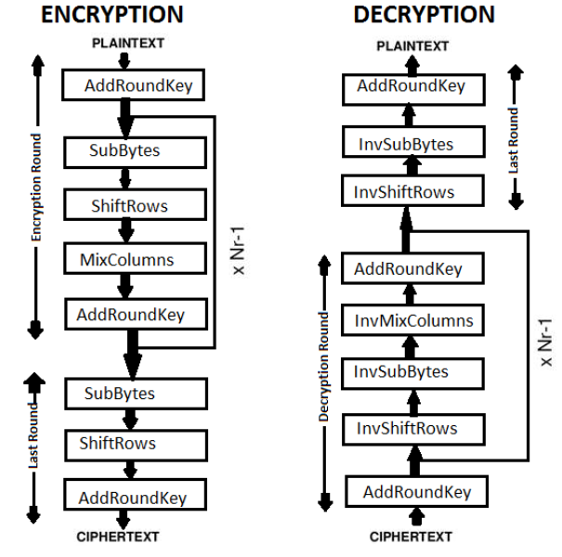

Slide 14
MODULES
MODULE 1: It will encryption the data (audio,vedieo,text,image) which you have been selected
Module3:When you wish to double-check your data, You can open your file if you decrypt the data.
MODULE 2:It will safeguard the data and prevent others from viewing it after encryption.

Slide 15
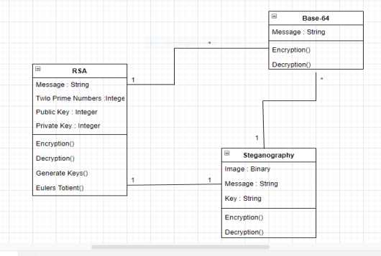
UML Diagrams
Class Diagram:

Slide 16
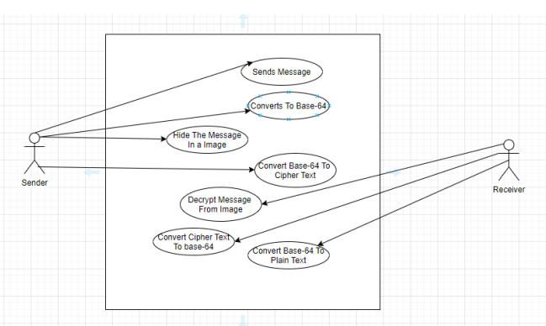
USE CASE DIAGRAM:

Slide 17
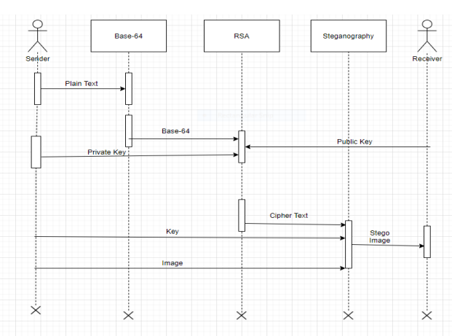
Sequential Diagram:

Slide 18
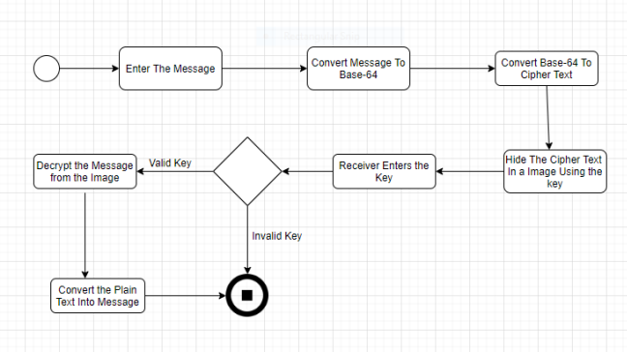
Activity Diagram:

Slide 19
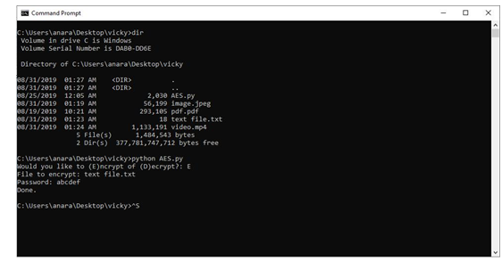
Data Base tables:

Slide 20
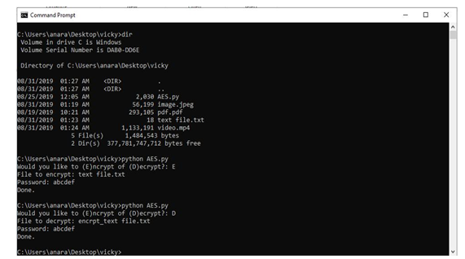

Slide 21
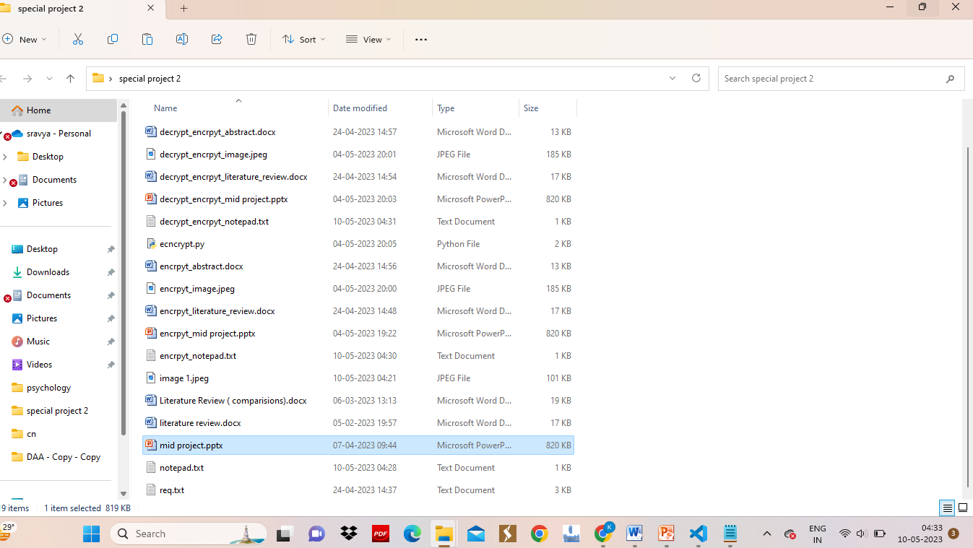

Slide 22
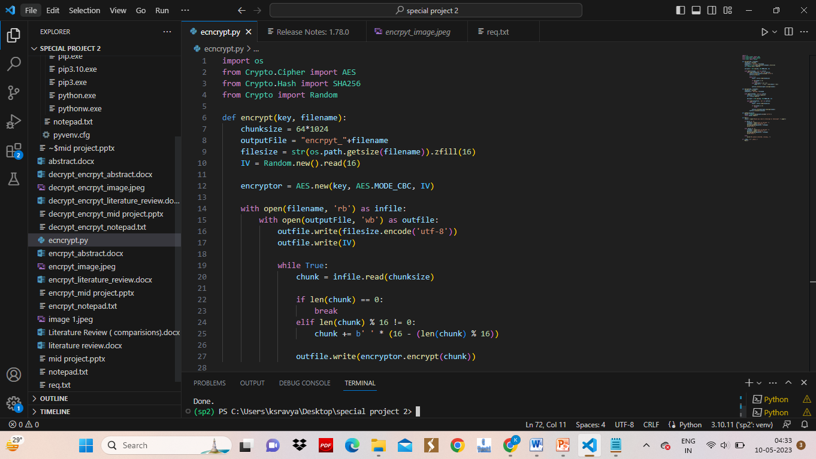
OUTPUT:
SOURCE CODE:

Slide 23
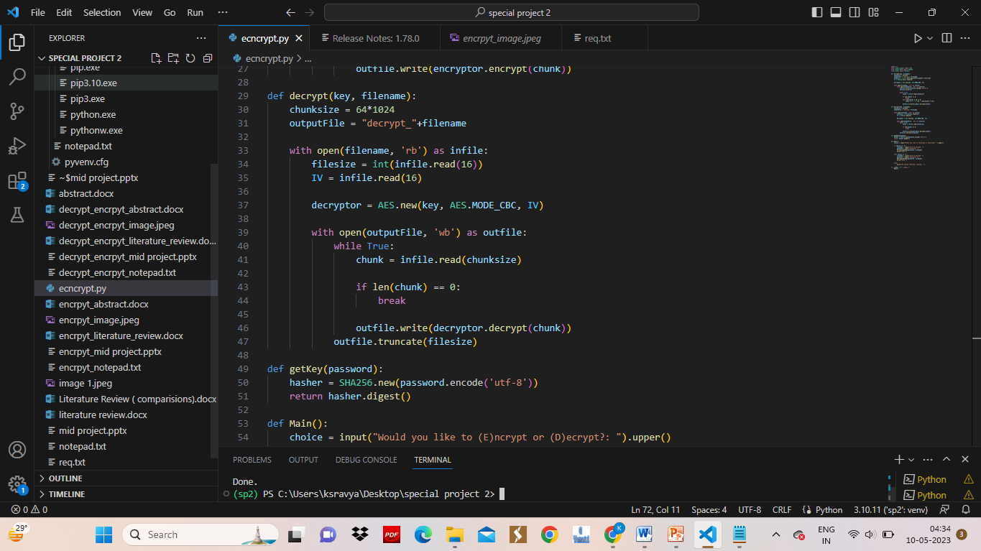
CODE IMPLEMENTATION:

Slide 24
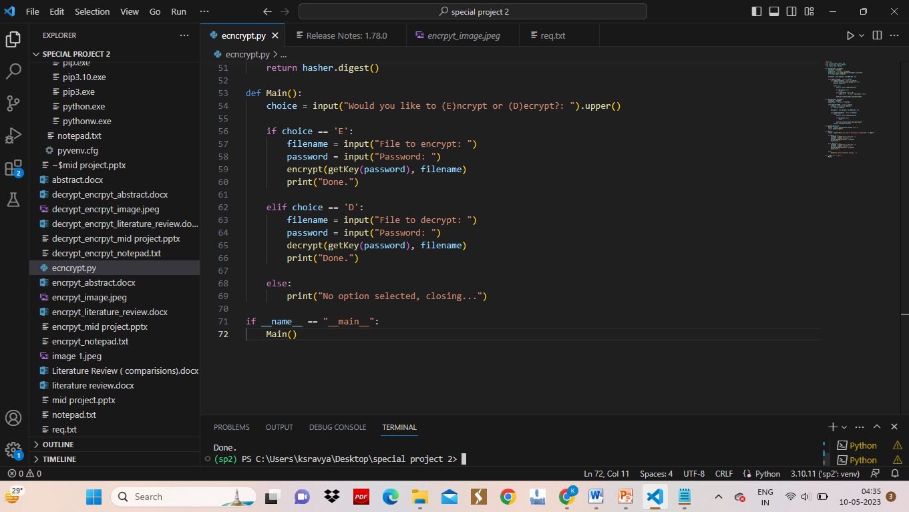

Slide 25
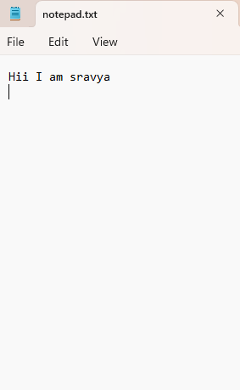
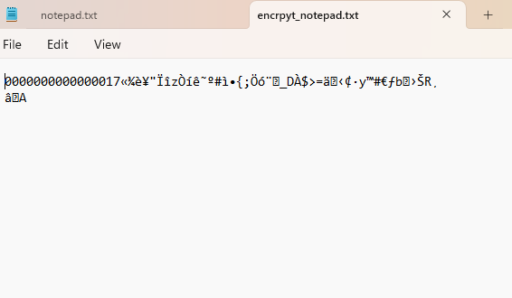
OUTPUT
File before encryption
File after encryption

Slide 26
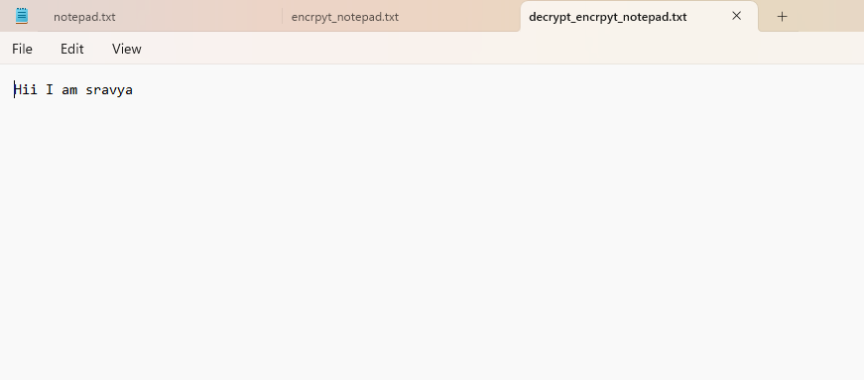
File after decryption

Slide 27
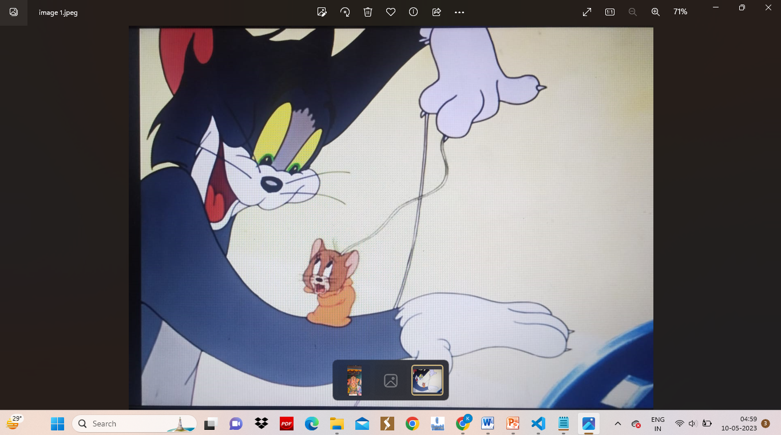
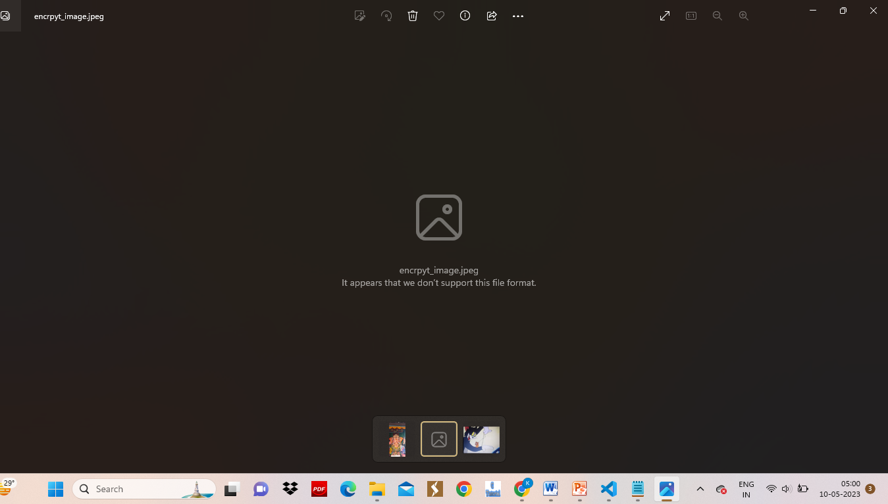
IMAGE before encryption
IMAGE after encryption

Slide 28
IMAGE after decryption

Slide 29
CONCLUSION
The project AES algorithm with python is for securing the data. It help to secure the files, images, videos that no other person can not under stand the file after encrypted. After we can decrypt the data with the password.
AES is the most secured and fast and they take many years to decrypt the encrypted data with password, it is very hard to decrypt the data with out password.

Slide 30


